Slide 2
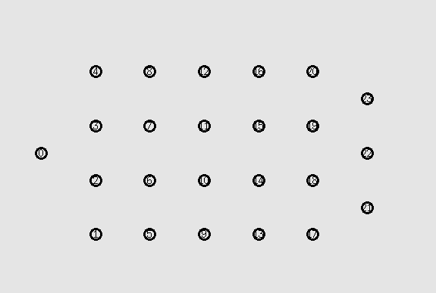
D
E
S
T
I N A T I O N
SOURCE

Slide 3
D
E
S
T
I N A T I O N
SOURCE

Slide 4
Last node moving VS Last node Static
Threshold | Packets in network | Coded Packets | Non-Coded Packets | Destination 21 Unique | Destination 22 Unique | Destination 23 Unique | Ratio
0 | 32485 | 21653 | 637 | 243 | 243 | 243 | 0.022441
0.1 | 32485 | 21653 | 637 | 243 | 243 | 243 | 0.022441
0.2 | 26298 | 10324 | 1127 | 145 | 145 | 145 | 0.016541
0.3 | 32763 | 2228 | 25689 | 242 | 242 | 242 | 0.022159
0.4 | 33196 | 909 | 27612 | 241 | 241 | 241 | 0.02178
0.5 | 33047 | 314 | 28413 | 243 | 243 | 243 | 0.022059
0.6 | 33416 | 87 | 29207 | 245 | 245 | 245 | 0.021995
Threshold | Packets in network | Coded Packets | Non-Coded Packets | Destination 21 Unique | Destination 22 Unique | Destination 23 Unique | Ratio
0 | 25996 | 16335 | 646 | 182 | 182 | 182 | 0.021003
0.1 | 25996 | 16335 | 646 | 182 | 182 | 182 | 0.021003
0.2 | 25973 | 11034 | 1377 | 156 | 156 | 156 | 0.018019
0.3 | 30370 | 2983 | 23326 | 242 | 242 | 242 | 0.023905
0.4 | 29078 | 734 | 25138 | 231 | 231 | 231 | 0.023832
0.5 | 30095 | 389 | 26347 | 237 | 237 | 237 | 0.023625
0.6 | 31336 | 107 | 27418 | 244 | 244 | 244 | 0.02336

Slide 5
Last node moving VS Last node Static
Threshold | Packets in network | Coded Packets | Non-Coded Packets | Destination 21 Unique | Destination 22 Unique | Destination 23 Unique | Ratio
0.1 | 32485 | 21653 | 637 | 243 | 243 | 243 | 0.022441
0.11 | 32485 | 21653 | 637 | 243 | 243 | 243 | 0.022441
0.12 | 32485 | 21653 | 637 | 243 | 243 | 243 | 0.022441
0.13 | 32485 | 21653 | 637 | 243 | 243 | 243 | 0.022441
0.14 | 32485 | 21653 | 637 | 243 | 243 | 243 | 0.022441
0.15 | 32485 | 21653 | 637 | 243 | 243 | 243 | 0.022441
0.16 | 32485 | 21653 | 637 | 243 | 243 | 243 | 0.022441
0.17 | 23207 | 13581 | 716 | 163 | 163 | 163 | 0.021071
0.18 | 16426 | 7951 | 707 | 89 | 89 | 89 | 0.016255
0.19 | 26412 | 10653 | 1132 | 147 | 147 | 147 | 0.016697
0.2 | 26298 | 10324 | 1127 | 145 | 145 | 145 | 0.016541
Threshold | Packets in network | Coded Packets | Non-Coded Packets | Destination 21 Unique | Destination 22 Unique | Destination 23 Unique | Ratio
0.1 | 25996 | 16335 | 646 | 182 | 182 | 182 | 0.021003
0.11 | 25996 | 16335 | 646 | 182 | 182 | 182 | 0.021003
0.12 | 25996 | 16335 | 646 | 182 | 182 | 182 | 0.021003
0.13 | 25996 | 16335 | 646 | 182 | 182 | 182 | 0.021003
0.14 | 25996 | 16335 | 646 | 182 | 182 | 182 | 0.021003
0.15 | 24202 | 15887 | 662 | 167 | 167 | 167 | 0.020701
0.16 | 35894 | 12433 | 693 | 165 | 165 | 165 | 0.013791
0.17 | 21402 | 15303 | 739 | 150 | 150 | 150 | 0.021026
0.18 | 30861 | 10600 | 760 | 180 | 180 | 180 | 0.017498
0.19 | 33863 | 8940 | 761 | 127 | 127 | 127 | 0.011251
0.2 | 25973 | 11034 | 1377 | 156 | 156 | 156 | 0.018019

Slide 6
Last node moving VS Last node Static
Threshold | Packets in network | Coded Packets | Non-Coded Packets | Destination 21 Unique | Destination 22 Unique | Destination 23 Unique | Ratio
0.2 | 26298 | 10324 | 1127 | 145 | 145 | 145 | 0.016541
0.21 | 22889 | 10274 | 4426 | 144 | 144 | 144 | 0.018874
0.22 | 30536 | 12469 | 8487 | 213 | 213 | 213 | 0.020926
0.23 | 28132 | 10943 | 8422 | 195 | 195 | 195 | 0.020795
0.24 | 25517 | 9461 | 7379 | 173 | 173 | 173 | 0.020339
0.25 | 33388 | 9936 | 13796 | 236 | 236 | 236 | 0.021205
0.26 | 28137 | 8017 | 11040 | 193 | 193 | 193 | 0.020578
0.27 | 31793 | 4294 | 23235 | 241 | 241 | 241 | 0.022741
0.28 | 32046 | 3519 | 24383 | 245 | 245 | 245 | 0.022936
0.29 | 32665 | 2955 | 25198 | 243 | 243 | 243 | 0.022317
0.3 | 32763 | 2228 | 25689 | 242 | 242 | 242 | 0.022159
Threshold | Packets in network | Coded Packets | Non-Coded Packets | Destination 21 Unique | Destination 22 Unique | Destination 23 Unique | Ratio
0.2 | 25973 | 11034 | 1377 | 156 | 156 | 156 | 0.018019
0.21 | 21569 | 11697 | 2737 | 155 | 155 | 155 | 0.021559
0.22 | 15542 | 6807 | 647 | 94 | 94 | 94 | 0.018144
0.23 | 29778 | 10926 | 10925 | 232 | 232 | 232 | 0.023373
0.24 | 25363 | 6980 | 1365 | 97 | 97 | 97 | 0.011473
0.25 | 59270 | 7731 | 7236 | 181 | 181 | 181 | 0.009161
0.26 | 30193 | 5796 | 19960 | 239 | 239 | 239 | 0.023747
0.27 | 30601 | 4162 | 22435 | 244 | 244 | 244 | 0.023921
0.28 | 31186 | 3606 | 23629 | 248 | 248 | 248 | 0.023857
0.29 | 30999 | 3390 | 23428 | 245 | 245 | 245 | 0.02371
0.3 | 30370 | 2983 | 23326 | 242 | 242 | 242 | 0.023905

Slide 7
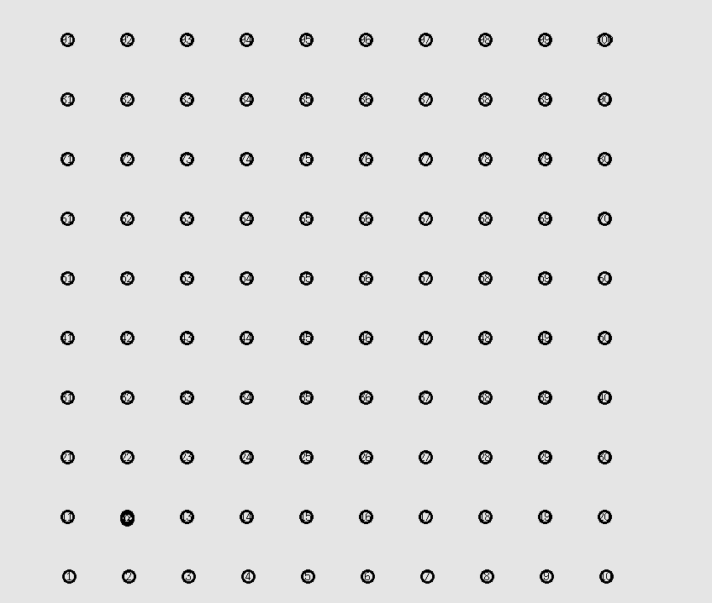

Slide 8
First Line Moving Vs One Hope Away Moving
Threshold | Packets in network | Coded Packets | Non-Coded Packets | Destination 10 Unique | Destination 91 Unique | Destination 100 Unique | Ratio
0 | 33593 | 33593 | 1634 | 90 | 89 | 90 | 0.008008
0.1 | 57674 | 57674 | 2433 | 174 | 174 | 174 | 0.009051
0.2 | 57682 | 57682 | 3929 | 179 | 178 | 179 | 0.009292
0.3 | 45769 | 45769 | 15991 | 178 | 179 | 178 | 0.011689
0.4 | 60595 | 13640 | 46440 | 175 | 177 | 177 | 0.00873
0.5 | 61749 | 889 | 60328 | 178 | 177 | 176 | 0.008599
0.6 | 62045 | 2 | 61522 | 178 | 178 | 178 | 0.008607
Threshold | Packets in network | Coded Packets | Non-Coded Packets | Destination 10 Unique | Destination 91 Unique | Destination 100 Unique | Ratio
0 | 7069 | 5712 | 1357 | 0 | 0 | 0 | 0
0.1 | 7069 | 5712 | 1357 | 0 | 0 | 0 | 0
0.2 | 7069 | 5712 | 1357 | 0 | 0 | 0 | 0
0.3 | 34113 | 34113 | 11212 | 121 | 122 | 121 | 0.01067
0.4 | 62200 | 16651 | 45147 | 176 | 176 | 177 | 0.008505
0.5 | 63603 | 3707 | 59587 | 178 | 179 | 179 | 0.008427
0.6 | 64538 | 910 | 63127 | 179 | 179 | 179 | 0.008321

Slide 9
First Line Moving Vs One Hope Away Moving
Threshold | Packets in network | Coded Packets | Non-Coded Packets | Destination 10 Unique | Destination 91 Unique | Destination 100 Unique | Ratio
0.2 | 56877 | 56877 | 4046 | 173 | 172 | 173 | 0.009107
0.21 | 47918 | 47918 | 4473 | 184 | 4 | 184 | 0.007763
0.22 | 46848 | 46848 | 4757 | 184 | 5 | 184 | 0.007962
0.23 | 54328 | 54328 | 4996 | 169 | 171 | 170 | 0.009387
0.24 | 55652 | 55652 | 5900 | 179 | 180 | 180 | 0.009685
0.25 | 54825 | 54825 | 6510 | 178 | 179 | 179 | 0.009777
0.26 | 54754 | 54754 | 7644 | 181 | 183 | 183 | 0.00999
0.27 | 47973 | 47973 | 8075 | 92 | 179 | 179 | 0.00938
0.28 | 41701 | 41701 | 10819 | 1 | 186 | 185 | 0.008921
0.29 | 41192 | 41192 | 11719 | 99 | 98 | 178 | 0.009104
0.3 | 46468 | 46468 | 15265 | 179 | 179 | 179 | 0.011556
Threshold | Packets in network | Coded Packets | Non-Coded Packets | Destination 10 Unique | Destination 91 Unique | Destination 100 Unique | Ratio
0.2 | 7069 | 5712 | 1357 | 0 | 0 | 0 | 0
0.21 | 7098 | 5736 | 1362 | 0 | 0 | 0 | 0
0.22 | 7004 | 5601 | 1403 | 0 | 0 | 0 | 0
0.23 | 6811 | 5388 | 1423 | 0 | 0 | 0 | 0
0.24 | 6977 | 5422 | 1555 | 0 | 0 | 0 | 0
0.25 | 11355 | 9229 | 2069 | 13 | 12 | 12 | 0.003258
0.26 | 12319 | 12319 | 2863 | 24 | 23 | 24 | 0.005763
0.27 | 14270 | 14270 | 3113 | 31 | 31 | 30 | 0.006447
0.28 | 18312 | 18312 | 4442 | 50 | 50 | 50 | 0.008191
0.29 | 18013 | 18013 | 4766 | 49 | 49 | 48 | 0.008105
0.3 | 34113 | 34113 | 11212 | 121 | 122 | 121 | 0.01067

Slide 10
First Line Moving Vs One Hope Away Moving
Threshold | Packets in network | Coded Packets | Non-Coded Packets | Destination 10 Unique | Destination 91 Unique | Destination 100 Unique | Ratio
0.31 | 42400 | 42400 | 20269 | 182 | 182 | 183 | 0.012901
0.32 | 39462 | 39462 | 22020 | 179 | 179 | 179 | 0.013608
0.33 | 35515 | 35515 | 25238 | 177 | 177 | 177 | 0.014951
0.34 | 29525 | 29525 | 29197 | 164 | 164 | 164 | 0.016664
0.35 | 27882 | 27882 | 31739 | 172 | 172 | 172 | 0.018507
0.36 | 59383 | 23776 | 35148 | 171 | 171 | 170 | 0.008622
0.37 | 22503 | 22503 | 37773 | 176 | 176 | 177 | 0.023508
0.38 | 21585 | 21585 | 38790 | 178 | 178 | 177 | 0.024693
0.39 | 19703 | 19703 | 40385 | 174 | 178 | 178 | 0.026899
0.4 | 60265 | 16247 | 43549 | 175 | 176 | 178 | 0.008778
Threshold | Packets in network | Coded Packets | Non-Coded Packets | Destination 10 Unique | Destination 91 Unique | Destination 100 Unique | Ratio
0.3 | 34113 | 34113 | 11212 | 121 | 122 | 121 | 0.01067
0.31 | 31678 | 31678 | 13623 | 121 | 121 | 120 | 0.011427
0.32 | 43586 | 43586 | 23845 | 192 | 192 | 192 | 0.013215
0.33 | 39337 | 39337 | 26960 | 189 | 189 | 189 | 0.014414
0.34 | 34854 | 34854 | 30014 | 184 | 184 | 184 | 0.015837
0.35 | 31418 | 31418 | 32540 | 181 | 181 | 181 | 0.017283
0.36 | 27313 | 27313 | 36593 | 182 | 182 | 182 | 0.01999
0.37 | 63502 | 24774 | 38220 | 177 | 178 | 176 | 0.008362
0.38 | 62345 | 21839 | 40062 | 175 | 175 | 175 | 0.008421
0.39 | 19926 | 19926 | 42541 | 177 | 176 | 177 | 0.026598
0.4 | 62200 | 16651 | 45147 | 176 | 176 | 177 | 0.008505

